Slide 1
UNIVERSITY INSTITUTE OF ENGINEERING
COMPUTER SCIENCE ENGINEERING
Master of Engineering
ADVANCED DATA STRUCTURES
&
ALGORITHMS
(23CSH-622)
By : Dr. Ranjit Singh (E10947)
INTRODUCTION
DISCOVER . LEARN . EMPOWER

Slide 2
Contents of the Syllabus
UNIT-I (15h)
Introduction to Basic Data Structures: Importance and need of good data structures and algorithms, Introduction to linear and non-linear data structure and its importance, Algorithms Complexity and Analysis. [3]
Linear and Non –Linear Data Structures : Arrays , Link Lists, Queues , Trees and related algorithms [6]
Advanced Data Structures: AVL Trees (Insertion , Deletion , Searching), Red-Black Trees, B-trees, B+trees, Heaps. Data structure for disjoint sets, Augmented data structures. [6]
UNIT-II (15h)
Searching and Sorting : Internal and External Sorting algorithms: Linear Search, Binary Search, Bubble Sort, Selection Sort, Insertion Sort, Shell Sort, Quick Sort, Heap Sort, Merge Sort, Counting Sort, Radix Sort and analysis of their complexities and Hashing [4]
Graphs & Algorithms: Representation, Type of Graphs, Depth- and breadth-first traversals, Planar graphs, isomorphism, graph coloring, covering and partition, Minimum Spanning Tree: Prim’s and Kruskal’s algorithms. [6]
String Matching Algorithms: Naïve String Matching, Suffix arrays, Suffix trees, Rabin-Karp, Knuth-Morris-Pratt, Booyer-Moore algorithm [5]

Slide 3
Contents of the Syllabus
UNIT-III (15h)
Approximation algorithms: Need of approximation algorithms: Introduction to P, NP, NP-Hard and NP-Complete Greedy Approach, Dynamic Approach, Knapsack, Huffman Coding, TSP, All pair shortest path, Longest Common Subsequence Problem, Matrix Chain Multiplication. [7]
Randomized algorithms: Introduction, type of randomized algorithms, Quick sort, min cut [4]
Online Algorithms: Introduction, Online Paging Problem, k-server Problem. Data compression: Huffman’s coding, BWT, LZW. [4]
Recommended Books:
1. Cormen, Leiserson, Rivest, Stein, “Introduction to Algorithms”, Prentice Hall of India, 3rd edition 2012.
2. Horowitz, Sahni and Rajasekaran, “Fundamental of Computer, Algorithms”, University Press (India), 2nd edition.
3. Aho, Haperoft and Ullman, “The Design and analysis of Computer Algorithms”, Pearson Education India.

Slide 4
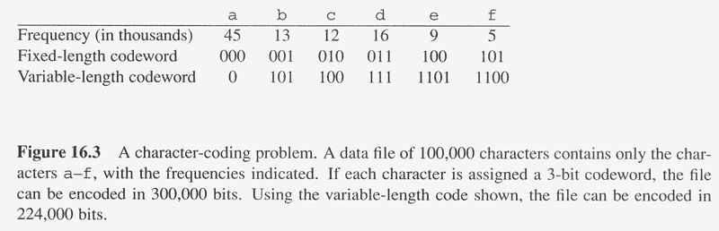
Overview
Huffman codes: compressing data (savings of 20% to 90%)
Huffman’s greedy algorithm uses a table of the frequencies of occurrence of each character to build up an optimal way of representing each character as a binary string
C: Alphabet

Slide 5
Example
Assume we are given a data file that contains only 6 symbols, namely a, b, c, d, e, f With the following frequency table:
Find a variable length prefix-free encoding scheme that compresses this data file as much as possible?

Slide 6
Huffman Code Problem
Left tree represents a fixed length encoding scheme
Right tree represents a Huffman encoding scheme

Slide 7
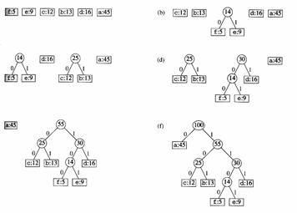
Example

Slide 8
Karger's Algorithm for Minimum Cut
Overview
In graph theory, a cut is a set of edges removal of which divides a connected graph into two non-overlapping (disjoint) subsets. The minimum cut (or min-cut) is defined as the minimum number of edges, when removed from a graph, divide the graph into two disjoint sets.
A randomized contraction algorithm .i.e. Karger's Algorithm is used to find the minimum cut of a graph in data structure.

Slide 9
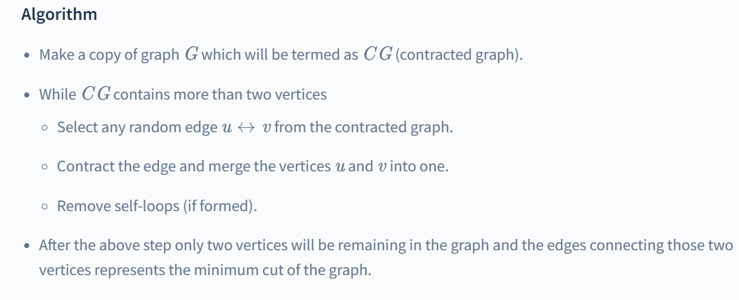
Karger's Algorithm for Minimum Cut

Slide 10
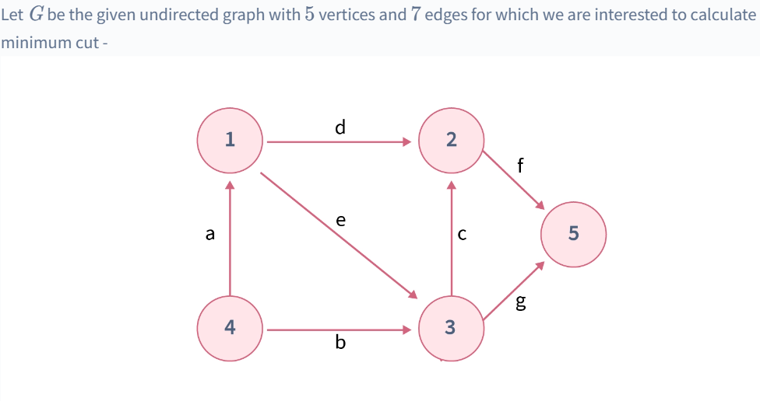
Karger's Algorithm for Minimum Cut

Slide 11
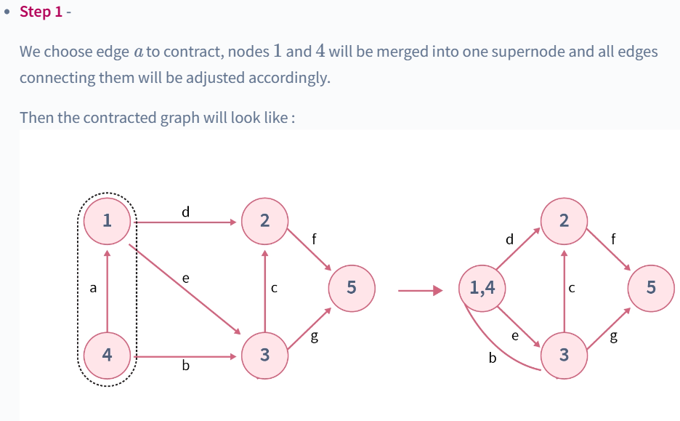
Karger's Algorithm for Minimum Cut

Slide 12
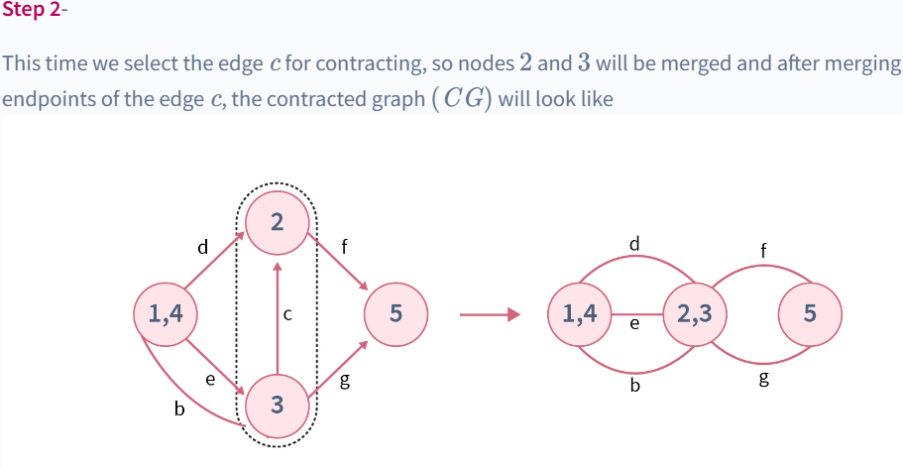
Karger's Algorithm for Minimum Cut

Slide 13
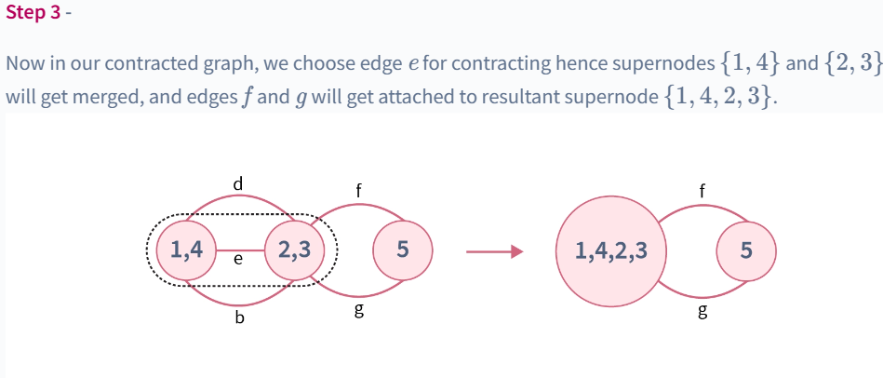
Karger's Algorithm for Minimum Cut

Slide 14
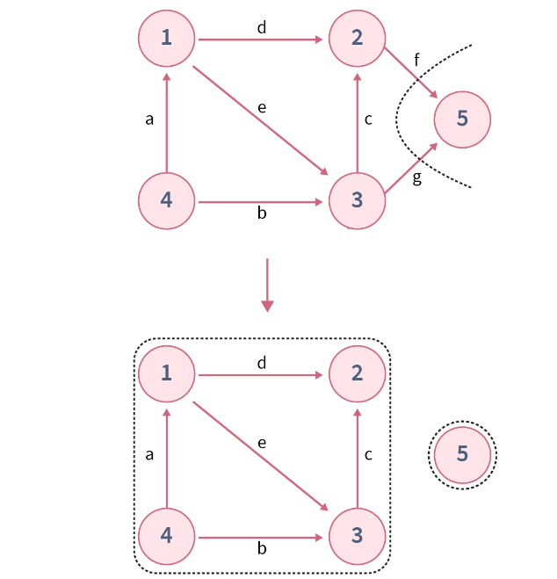
Karger's Algorithm for Minimum Cut

Slide 15
Karger's Algorithm for Minimum Cut
Karger's algorithm is a randomized algorithm (an algorithm which have some degree of randomness associated in its procedure) to compute a minimum cut of a connected, undirected, and unweighted graph G=(V, E). It is a "Monte Carlo" algorithm which means it may also produce a wrong output with a certain (usually low) probability.
As Karger algorithm being a "Monte Carlo" algorithm can also give wrong answers so by repeating the algorithm many times the minimum cut of the graph can be found with a certainly high probability.

Slide 16
Data Compression

Slide 17
Introduction to Compression
What happens in data compression ?
The general problem of compression is to reduce the amount of data required to represent a digital entity.
Data compression involves minimizing the size (in bytes) of an data or image file. This reduces the amount of disk space or memory required to store the data.
The key challenge to compressing a data is to identify and remove redundancy in all forms.

Slide 18
Example 1
The amount of data required for digital images is enormous. For example, a single 512×512, 8-bit image requires 2,097,152 bits for storage. If we wanted to transmission this image over the World Wide Web, it would probably take minutes for transmission –too long for most people to wait.
512 ×512×8= 2,097,152.
Example
To transmit a digitized color scanned at 3,000×2,000 pixels, and 24 bits, at 28.8 kbps, it would take about
(3000 *2000 pixels)(24 bits/pixels ) _{= 4883 second} (28.8*1024 bits / second) = 81 minutes.

Slide 19
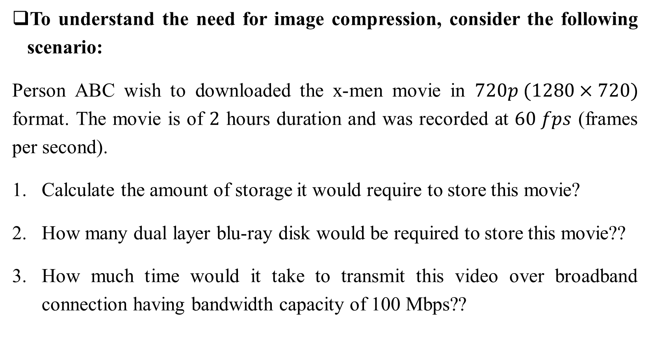
Example 2

Slide 20
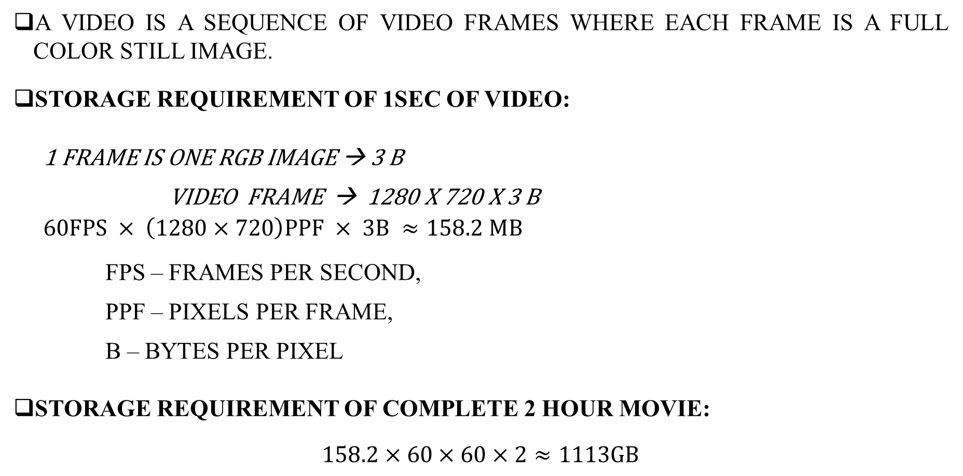
Introduction

Slide 21
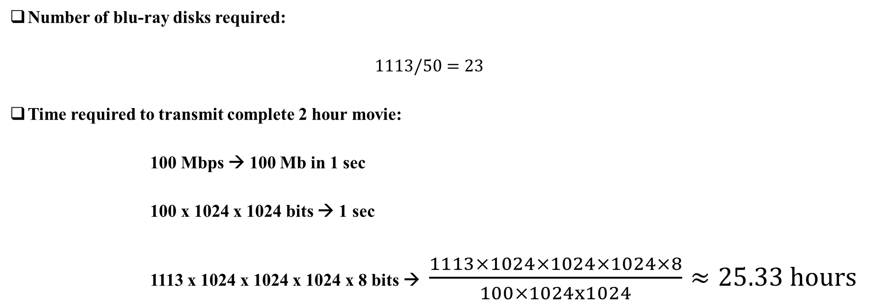
Introduction

Slide 22
This explains the power and need of data compression.
We need to do data Compression, so that there is requirement of
Low STORAGE
Less Transmission time

Slide 23
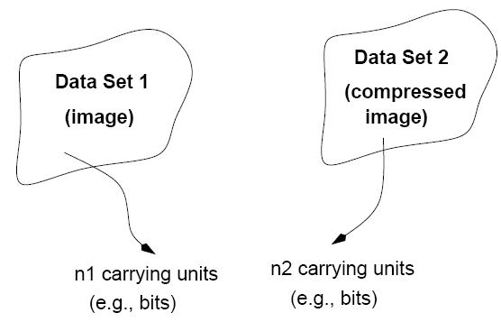
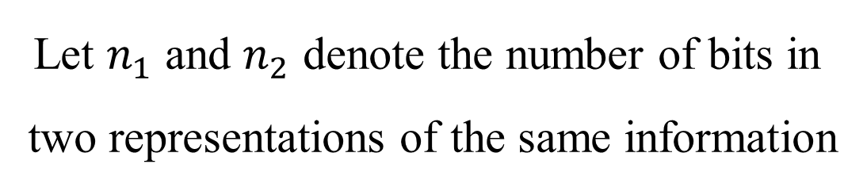
Compression Ratio
compression

Slide 24
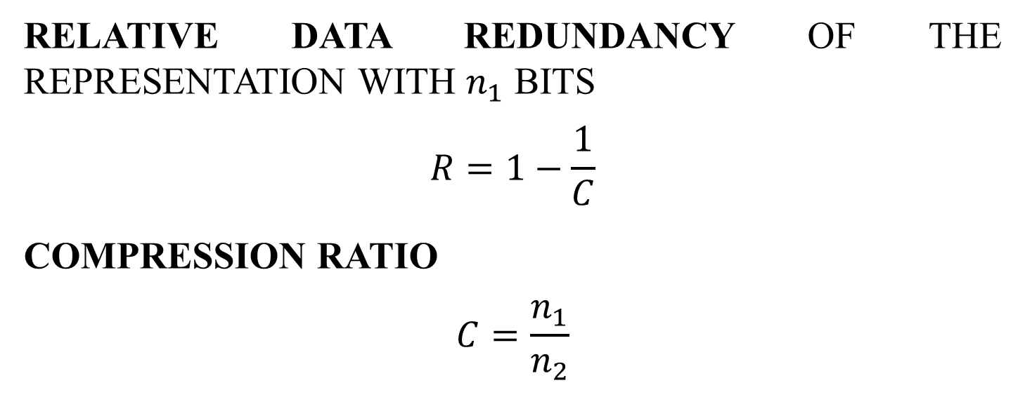
Compression Ratio

Slide 25
Types of Data Redundancy
Three principal types of data redundancies that can be identified and exploited in digital images
Coding redundancy
Spatial or temporal (interpixel) redundancy
Psychovisual redundancy (irrelevant information)
Data compression attempts to reduce one or more of these redundancy types.

Slide 26

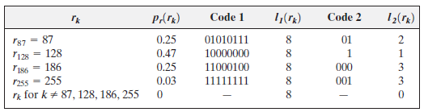
Coding Redundancy
The 8-bit codes that are used to represent the intensities in most 2-D intensity arrays contain more bits than are needed to represent the intensities.
Because, we go for uniform coding, in general.
We can solve the problem by variable length coding.

Slide 27
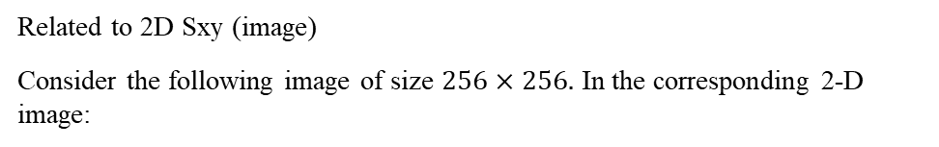

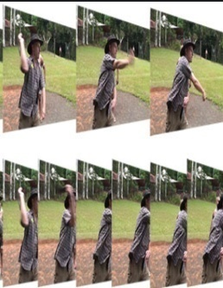
Spatial or Temporal (interpixel) Redundancy
Interpixel redundancy implies that pixel values are correlated
(i.e., A pixel value can be reasonably predicted by its neighbors).
Temporal
Spatial
Related to 3D (videos)
frame is moving w.r.t time (t)
refresh rate = 60 fps
At same coordinate (x,y) and diff times say t1, t2, t3,…. that intensity remains same
256, 255
256, 0
256, 1
Y
X
t (Z)
t1
t2

Slide 28

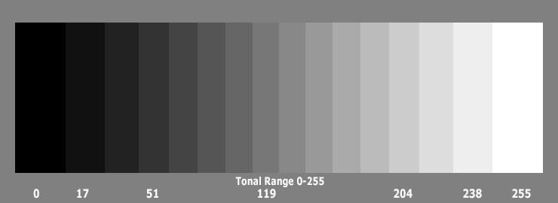
PSYCHOVISUAL REDUNDANCY
(irrelevant information)
Most images contain information that is ignored by the human visual system and/or irrelevant to the intended use of the image. It is redundant in the sense that it is not used.

Slide 29
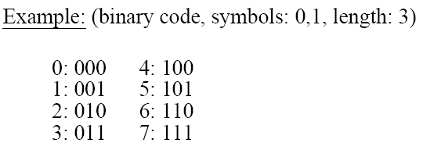
Coding - Definitions
Code: a list of symbols (letters, numbers, bits etc.)
Code word: a sequence of symbols used to represent some information (e.g., Gray levels).
Code word length: number of symbols in a code word.
CODE : CODE WORD
Notes:
29

Slide 30
Coding Redundancy
Code 1 equal length code
Code 2 variable length code
(obt by Huffman Coding)
Min bits 🡪 higher probability

Slide 31
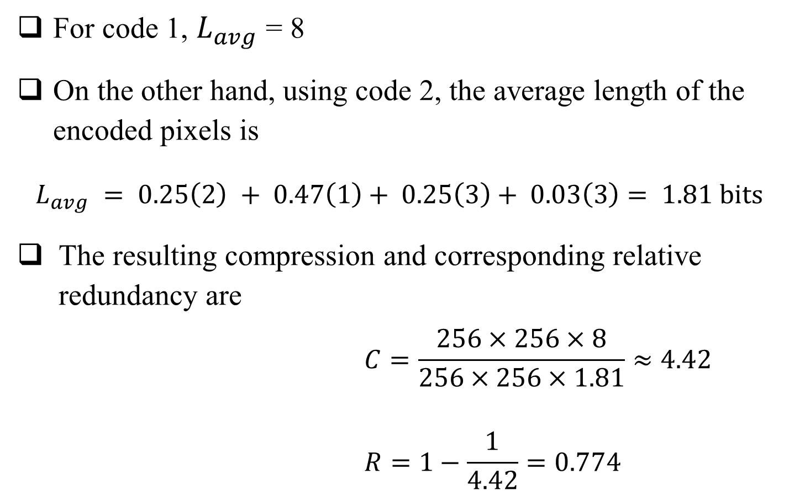
Coding Redundancy
Thus, 77.4% of the data in the original 8-bit 2-D intensity array is redundant.

Slide 32
Coding Redundancy
Coding redundancy is present when the codes assigned to intensity values do not take full advantage of their probabilities of occurrence.
The natural consequence is that, for most images, certain intensities are more probable than others.
A natural binary encoding assigns the same number of bits to both the most and least probable values, failing to minimize and resulting in coding redundancy.

Slide 33
Compression Method
There are two types of compression methods:
Lossy compression
Lossless compression

Slide 34
Lossless Compression
Error free compression techniques generally are composed of two relatively independent operations;
i) Devising an alternative representation of the image in which inter-pixel redundancies are reduced.
ii) Coding the representation to eliminate coding redundancies.

Slide 35
Lossless Compression
There are some error free compression strategies that are currently in use;
Huffman coding
Arithmetic coding
LZW coding
Bit-Plane coding
Lossless Predictive coding

Slide 36
Dealing with Coding Redundancy
The simplest approach to error-free image compression is to reduce only coding redundancy.
The most popular encoding technique is the Huffman coding.

Slide 37
Huffman Coding
A measure to reduce coding redundancy
Most popular coding redundancy technique
Variable length code
Min length code is assigned to one with highest probability

Slide 38
Dealing with Coding Redundancy
Huffman coding: It provides the smallest possible number of code symbols per source symbol.
Basic idea: Different gray levels occur with different probability (non uniform histogram). Use shorter code words for the more common gray levels and longer code words for less common gray levels. This is called Variable Code Length.

Slide 39
Dealing with Coding Redundancy
Firstly
1. Sort the gray levels by decreasing probability.
2. Sum the two smallest probabilities.
3. Sort the new value into the list.
4. Repeat 1 to 3 until only two probabilities remains.
Second
Give the code 0 to the highest probability, and the code
to the lowest probability in the summed pair.
2. Go backwards through the tree one node and repeat
from 1 until all gray levels have a unique code.

Slide 40
HUFFMAN CODING
Say, Image size: 10 x 10 (5 bit image)
Frequency:
a2 = 40 a6 = 30 a1 = 10 a4 = 10 a3 = 6
a5 = 4

Slide 41
HUFFMAN CODING
Say, Image size: 10 x 10 (5 bit image)
Frequency:
a2 = 40 a6 = 30 a1 = 10 a4 = 10
a3 = 6 a5 = 4
P(a2) = 40/100 = 0.4
Symbols (like intensity levels) | Probabilities (sorted) | Source Reduction (do till two values are left) (Maintain in sorted order here as well)
 |  | 1 | 2 | 3 | 4
a2 | 0.4 | 0.4 | 0.4 | 0.4 | 0.6
a6 | 0.3 | 0.3 | 0.3 | 0.3 | 0.4
a1 | 0.1 | 0.1 | 0.2 | 0.3
a4 | 0.1 | 0.1 | 0.1
a3 | 0.06 | 0.1
a5 | 0.04

Slide 42
Symbols (like intensity levels) | Probabilities (sorted) | Source Reduction (do till two values are left) (Maintain in sorted order here as well)
 |  | 1 | 2 | 3 | 4
a2 | 0.4 1 | 0.4 | 0.4 | 0.4 | 0.6 0
a6 | 0.3 00 | 0.3 | 0.3 | 0.3 00 | 0.4 1
a1 | 0.1 011 | 0.1 | 0.2 010 | 0.3 01
a4 | 0.1 0100 | 0.1 0100 | 0.1 011
a3 | 0.06 01010 | 0.1 0101
a5 | 0.04 01011
Encoded String: 01010 011 1 1 00
Decoding : a3 a1 a2 a2 a6
Parameters:
Average length of code
Lavg = 0.4 * 1 + 0.3 * 2 + 0.1 * 3 + 0.1 * 4 + 0.06 * 5 + 0.04 * 5 = 2.2 bits/symbol
Total no. of bits to be transmitted
10 * 10 * 2.2 = 220 bits
Entropy = 2.1396/symbol
How much you saved = 10 * 10 * 5 – 10 * 10 * 2.2 = 0.56 = 56%
10 * 10 * 5

Slide 43
HUFFMAN CODING
Say, Image size: 10 x 10 (5 bit image)
Frequency:
a2 = 40 a6 = 20 a1 = 20 a4 = 10 a3 = 8
a5 = 2

Slide 44
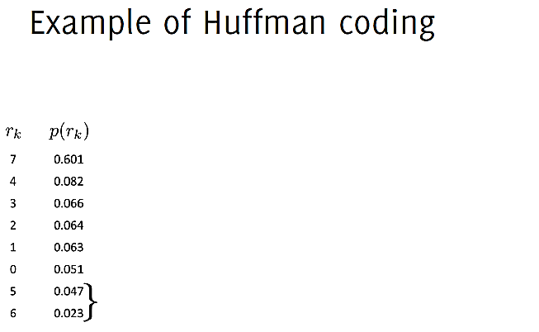
Huffman Coding

Slide 45
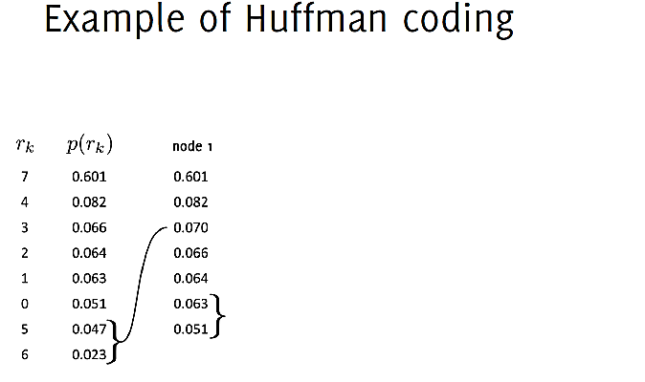
Huffman Coding

Slide 46
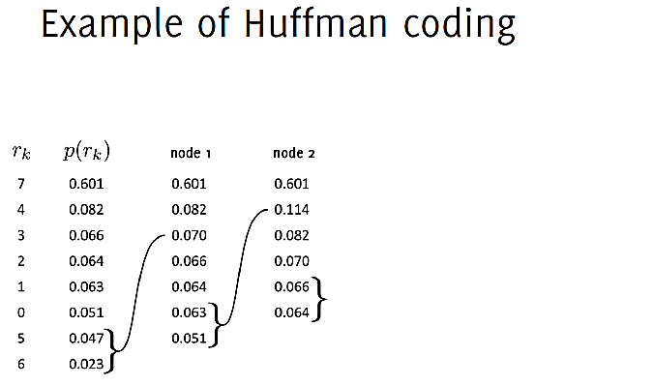
Huffman Coding

Slide 47
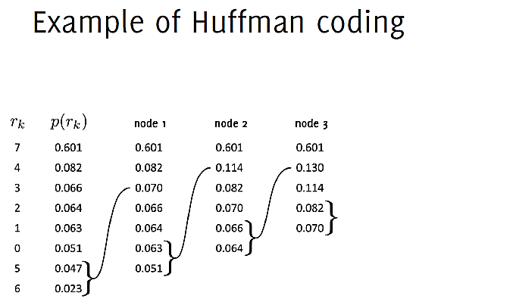
Huffman Coding

Slide 48
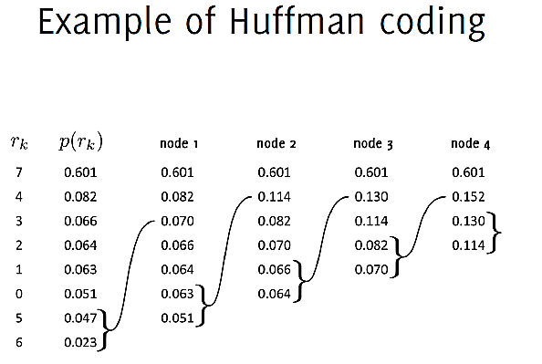
Huffman Coding

Slide 49
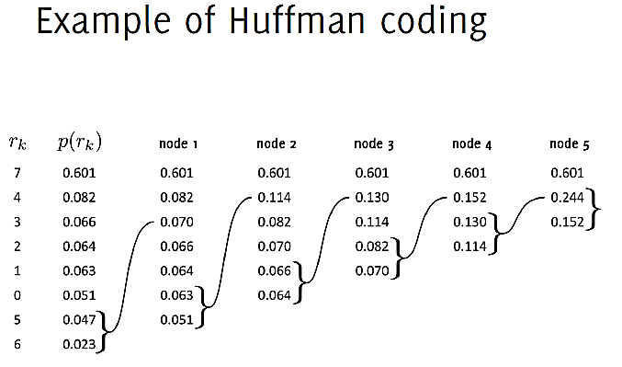
Huffman Coding

Slide 50
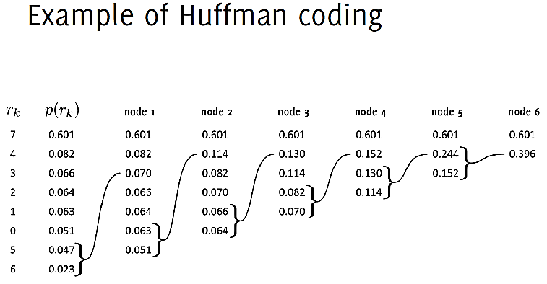
Huffman Coding

Slide 51
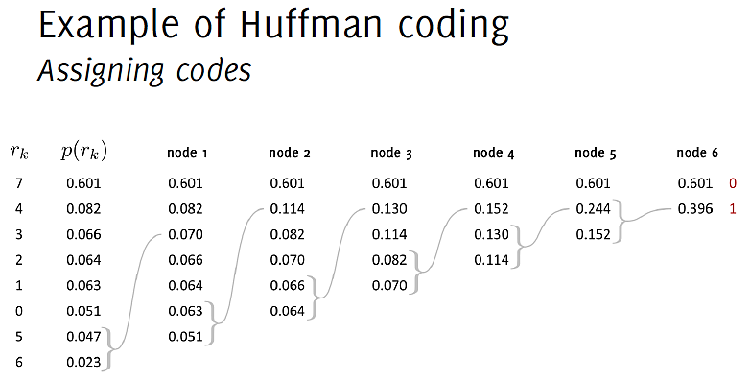
Huffman Coding

Slide 52
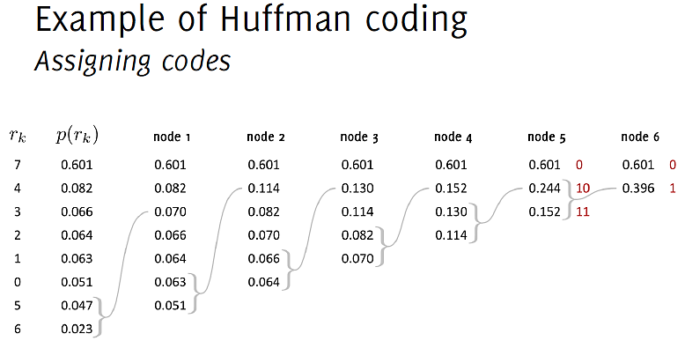
Huffman Coding

Slide 53
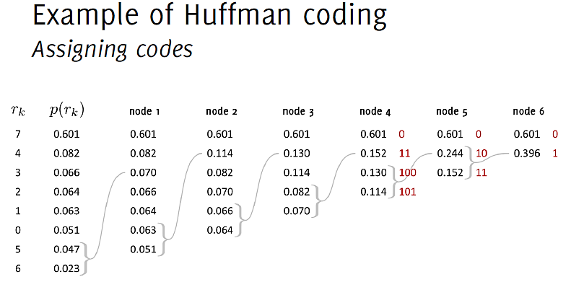
Huffman Coding

Slide 54
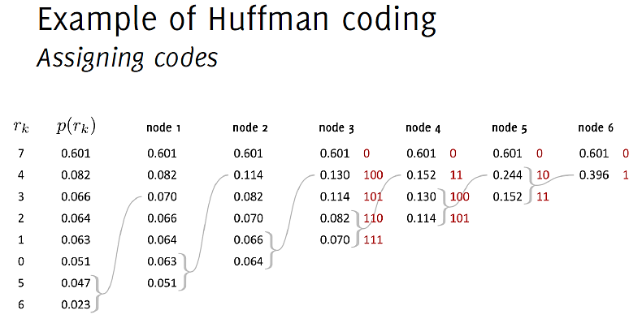
Huffman Coding

Slide 55
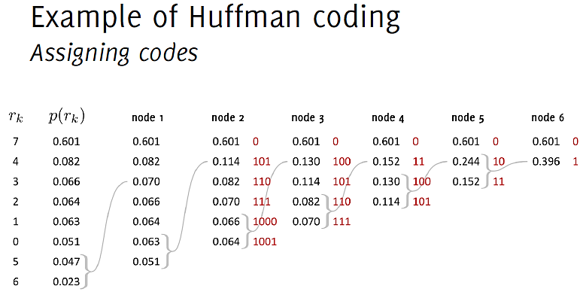
Huffman Coding

Slide 56
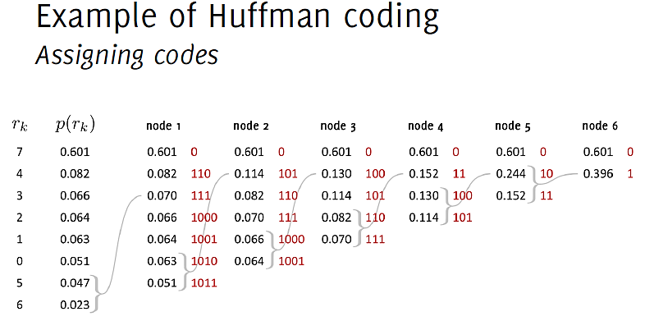
Huffman Coding

Slide 57
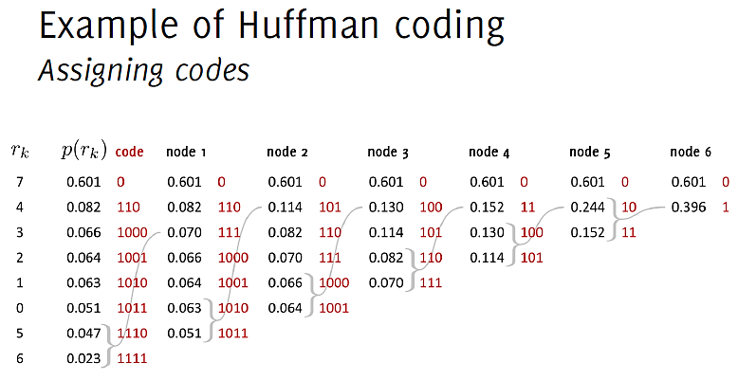
Huffman Coding

Slide 58
Huffman Coding
The resulting code is unambiguous.
–That is, for the previous example,
the encoded string 011011101011 can only be parsed into the code words 0, 110, 1110, 1011 and decoded as 7, 4, 5, 0.

Slide 59
One More Example

Slide 60
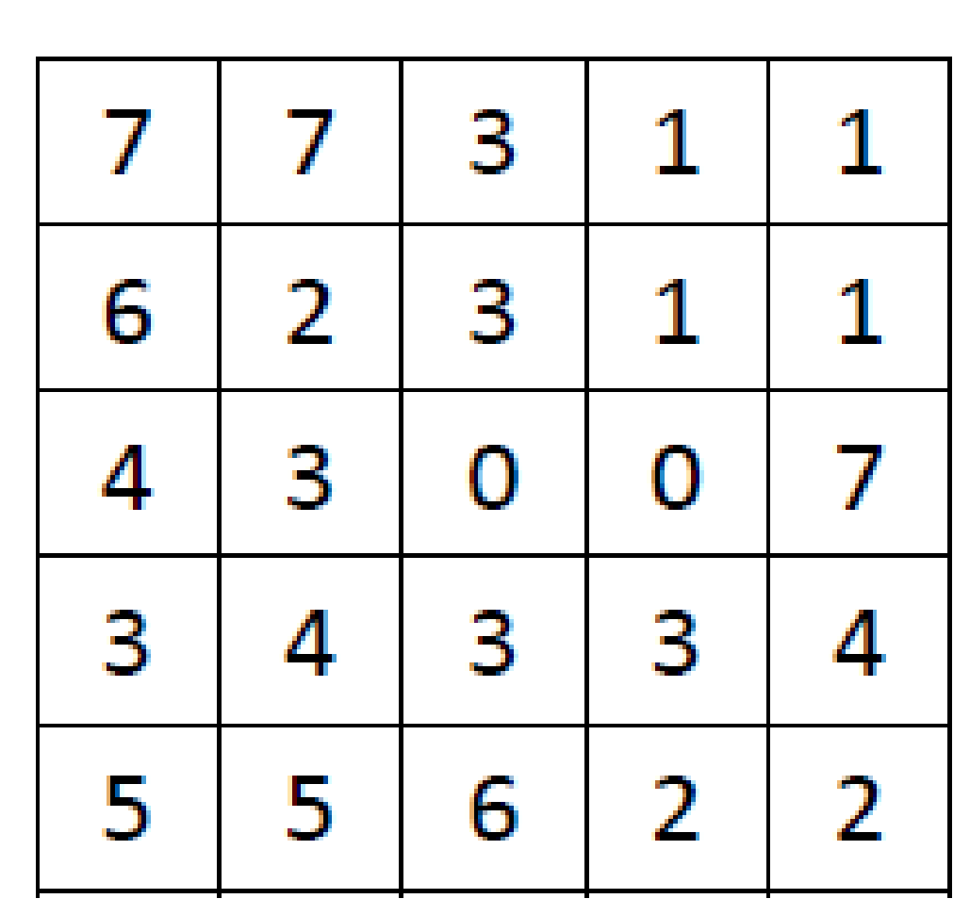
Find out the Lavg for the given image intensity levels using Huffman Coding

Slide 61
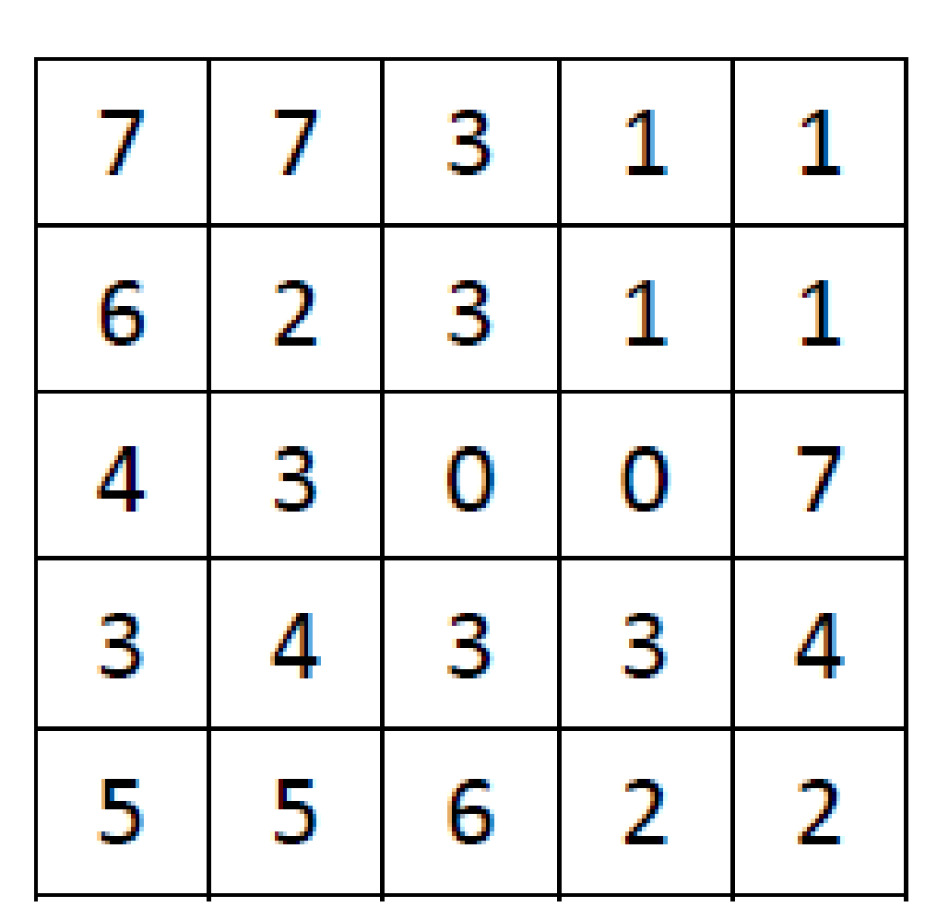
HUFFMAN CODING : EXAMPLE
SYMBOL | FREQUENCY | PROBABILITY (FREQUENCY/25)
0 | 2 | 0.08
1 | 4 | 0.16
2 | 3 | 0.12
3 | 6 | 0.24
4 | 3 | 0.12
5 | 2 | 0.08
6 | 2 | 0.08
7 | 3 | 0.12
IMAGE

Slide 62
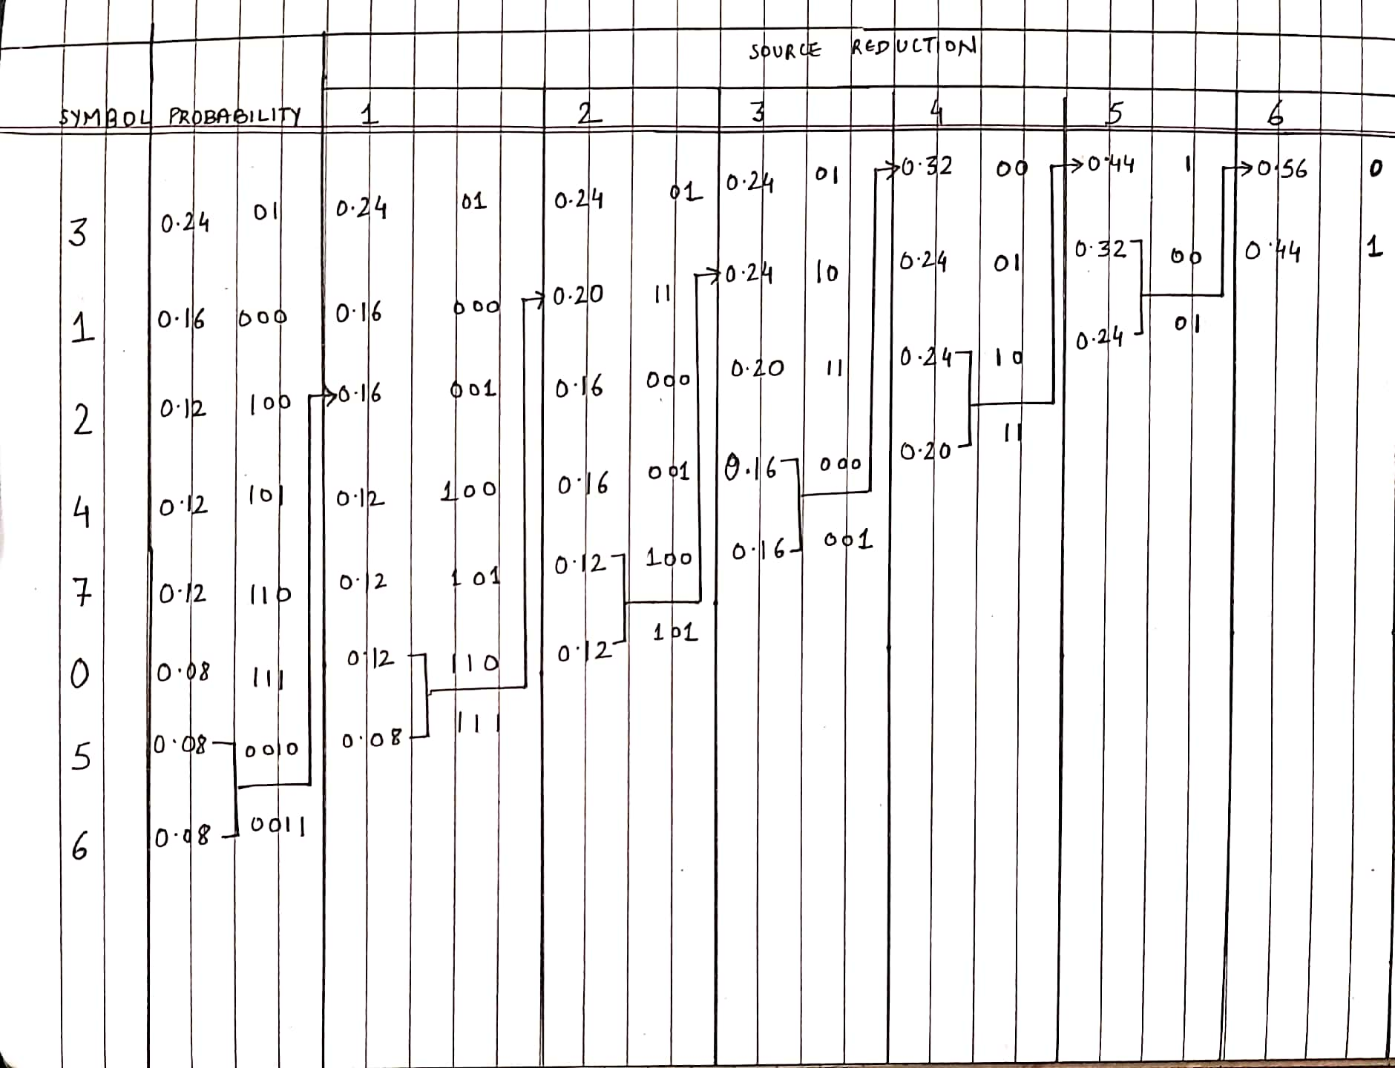

Slide 63
SYMBOL | CODE | PROBAB
0 | 111 | 0.08
1 | 000 | 0.16
2 | 100 | 0.12
3 | 01 | 0.24
4 | 101 | 0.12
5 | 0010 | 0.08
6 | 0011 | 0.08
7 | 110 | 0.12
Lavg = 2.92 bits/symbol
Entropy (H) = 2.892878689 bits/symbol

Slide 64
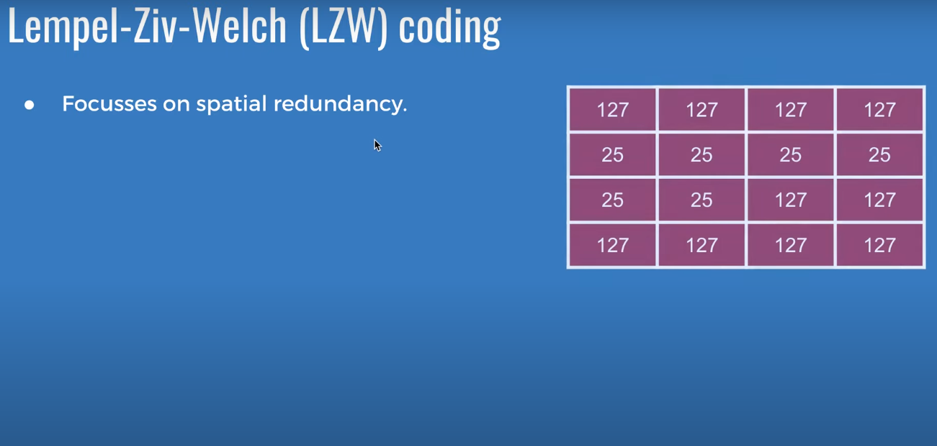

Slide 65
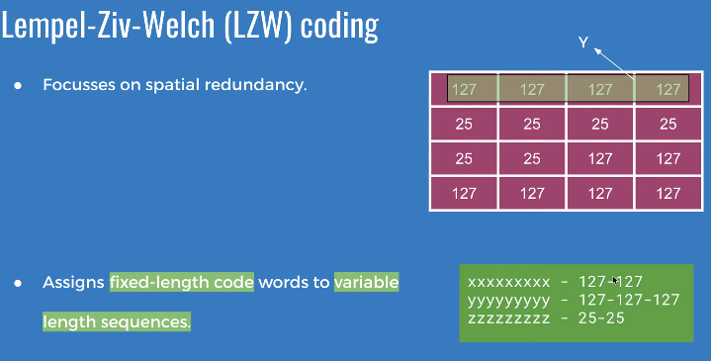

Slide 66
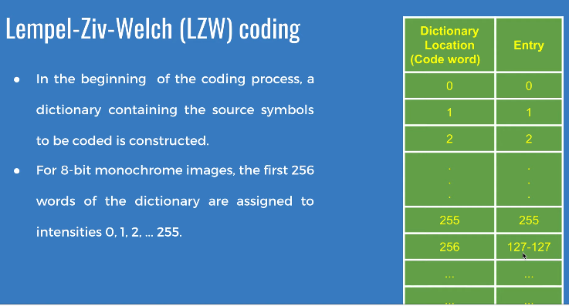

Slide 67
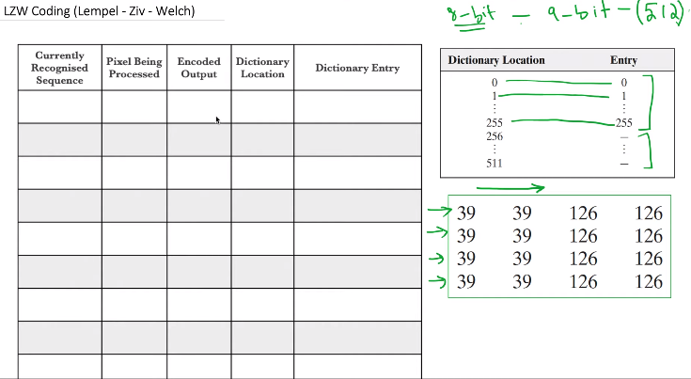

Slide 68
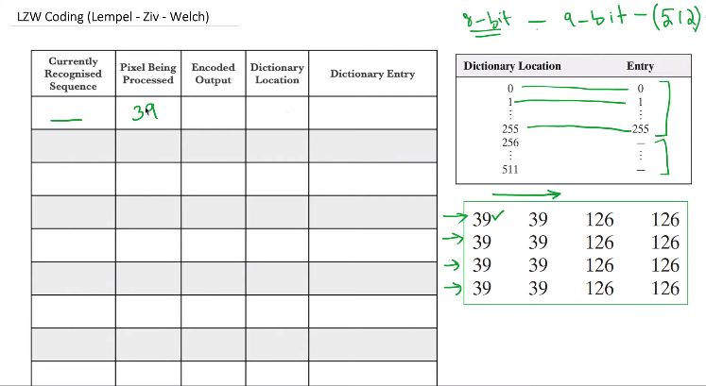

Slide 69
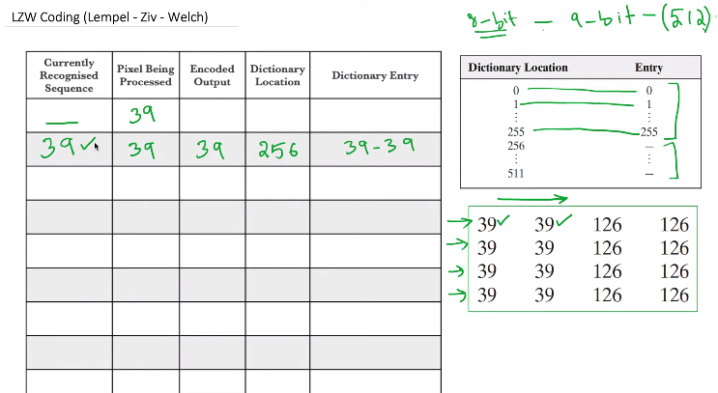

Slide 70
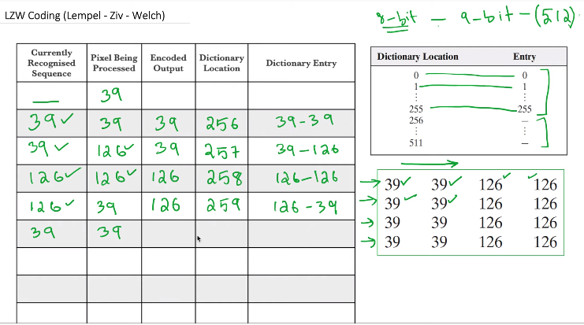

Slide 71
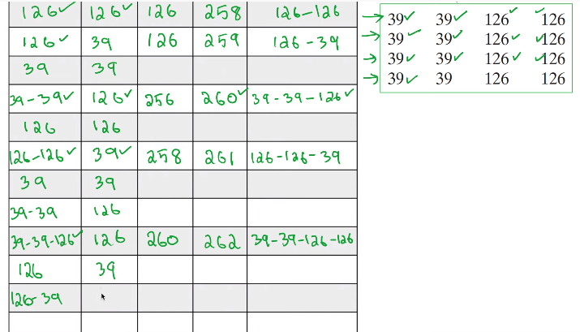

Slide 72
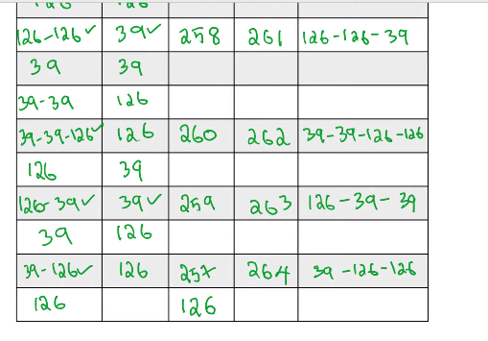

Slide 73
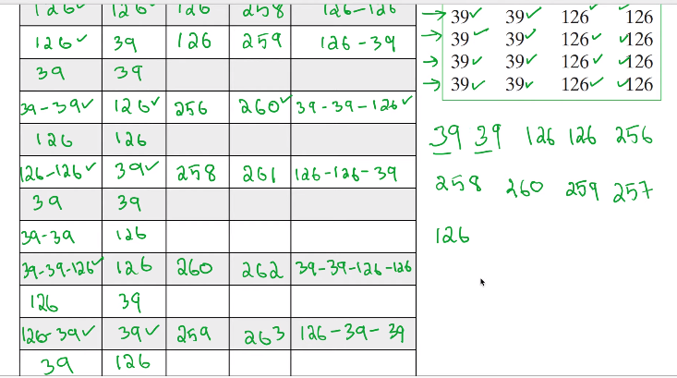

Slide 74
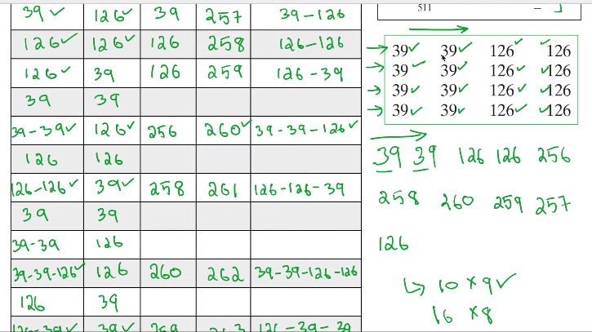

Slide 75
Burrows – Wheeler Data Transform Algorithm
The BWT is a data transformation algorithm that restructures data in such a way that the transformed message is more compressible.
Technically, it is a lexicographical reversible permutation of the characters of a string.
It is first of the three steps to be performed in succession while implementing the Burrows-Wheeler Data Compression algorithm that forms the basis of the Unix compression utility bzip2.

Slide 76
Why BWT? The main idea behind it.
The most important application of BWT is found in biological sciences where genomes(long strings written in A, C, T, G alphabets) don’t have many runs but they do have many repeats.
The idea of the BWT is to build an array whose rows are all cyclic shifts of the input string in dictionary order and return the last column of the array that tends to have long runs of identical characters.
The benefit of this is that once the characters have been clustered together, they effectively have an ordering, which can make our string more compressible for other algorithms like run-length encoding and Huffman Coding.
The remarkable thing about BWT is that this particular transform is reversible with minimal data overhead.

Slide 77
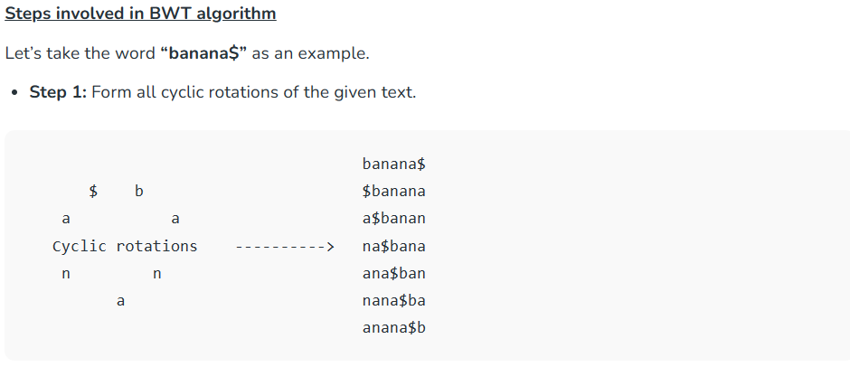

Slide 78
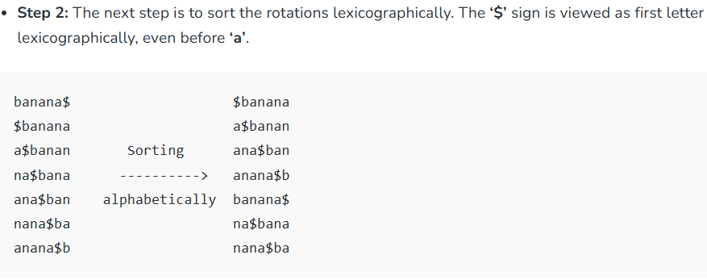

Slide 79

Another Example:
Input: text = “abracadabra$”
Output: Burrows-Wheeler Transform = ?

Slide 80
Another Example:
Input: text = “abracadabra$”
Output: Burrows-Wheeler Transform = “ard$rcaaaabb”

Slide 81
Thank you

